Slide 1
Dealing
with
Complexity
Igor Savin
Normalis Tech Principal Engineer
Notes:
Today I would like to talk about my favourite topic: complexity. Now this is a huge subject and we can’t possible cover all possible aspects of it in just one presentation, so for today I’m going to focus on introducing the complexity problem that we encounter in software engineering, explain a bit the science part of it, and then briefly touch upon how we can begin the process of solving it.

Slide 2
Part 0: What do we talk about
when we talk about
complexity
The most fundamental problem in computer science is problem decomposition: how to take a complex problem and divide it up into pieces that can be solved independently.
The greatest limitation in writing software is our ability to understand the systems we are creating. As a program evolves and acquires more features, it becomes complicated, with subtle dependencies between its components.
Notes:
Next page: inherent vs accidental

Slide 3
Complexity is anything related to the structure of a software system that makes it hard to understand and modify the system.
“Inherent complexity is that the problem is hard, incidental complexity is because we [the makers of software] are bad at our jobs” (J. B. Rainsberger)

Slide 4
Part 1: Science!
Notes:
First of all, in order to understand what we are talking about, let’s take a look about what cognitive psychology can teach us with regards to how humans handle complexity.

Slide 5
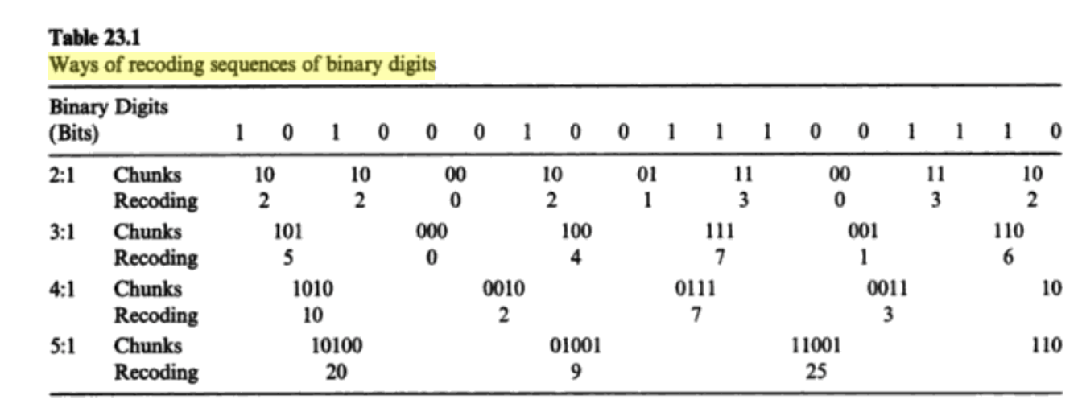
Which one do you think is the easiest to remember?
Notes:
There was a famous experiment were people were asked to remember a sequence of digits (ones and zeroes). First, they had to remember isolated numbers. Then numbers grouped by two. Then by three. Et cetera.
Which group do you think provided the most accurate results? Source: Sydney Smith’s experiment in 1954

Slide 6
The “group of 5” option consistently demonstrated the best results.
Notes:
Even though participants had to memorize more complex elements (not just 0/1, but a wider range of numbers), that still increased their effectiveness. There is an explanation for this.

Slide 7
Chunking
We are much better at remembering groups
than individual items.
Notes:
Our brain is naturally better at understanding and remembering higher order cognitive representation of items as a group than individual items themselves;
In cognitive psychology this is called “chunking”.

Slide 8
Now what do you think was the optimal group size?

Slide 9
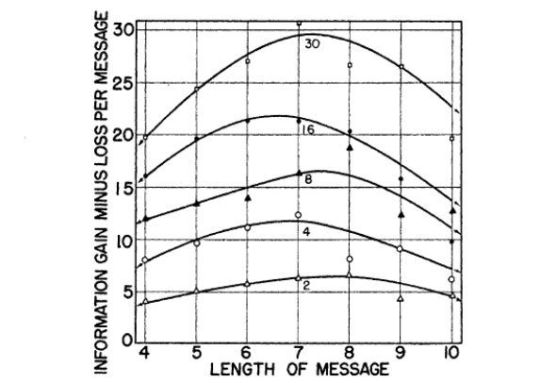
And the answer is: 7 (plus or minus 2)
Notes:
Most adults can store between 5 and 9 items in their short-term memory. This idea was put forward by Miller (1956) and he called it “the magic number 7”. It was since confirmed by many other independent studies. In order to handle anything beyond that, we have to let go of the previous ones, so the holistic picture begins to escape us.

Slide 10
Implications for software engineering
How many methods of a class can you remember?
How many classes in a directory?
How many endpoints in a service?
How many developers in a Scrum team?
Notes:
This has a very important implications for the software engineering: ask yourself, can you easily list all the methods of a class if it has ten of them? How many files in a single directory should there be before it starts to feel cluttered and you get a feeling that maybe additional subdirectories are a good idea? How many developers is it recommended to have in a Scrum team?
7 is a good rule of a thumb approximation for the acceptable amount of elements in the same cognitive unit.
But what do we do when we have to handle implicitly complex cases that do inherently involve large amount of moving pieces?

Slide 11
Part 2: Understanding the heart of the problem
Notes:
Before trying to solve the problem of complexity, it doesn’t hurt to understand what are the reasons that make code complex in a way that matters. Unfortunately, too often we are inclined to treat symptoms rather than the causes, and attack completely wrong problem, which is not dissimilar to microoptimizing your code in areas that are not actual bottlenecks. Best analogy for that that I’ve ever heard is this one: imagine that you need 30 apples, and there is a store across the road that sells them. You go to the store, you buy one apple, you go home, you put apple on the table, you go to the store, you buy another one. By fifth apple you figure out that process is going slower than you’d like, so you leave your door unlocked to save time on opening it, then get contactless payment card in order not to enter PIN code, then take running lessons, but rate at which you are getting your apples is not really improving. Because - you guessed it - the actual problem is that you are buying one apple at a time, instead of a whole bag of them. Before we can start solving the problem of complex code, we need to understand what actually makes code complex in a way that matters. So, what does make code complex in a way that matters?

Slide 12
“The slow one now will later be fast, As the present now will later be past”
“Indeed, the ratio of time spent reading versus writing is well over 10 to 1. We are constantly reading old code as part of the effort to write new code. Therefore, making it easy to read makes it easier to write.”
Robert C. Martin, “Clean Code: A Handbook of Agile Software Craftsmanship”
Notes:
I invite you to read the quote from Robert Martin, which I find to be one of the most important observations in the whole field of software engineering.
I can’t possibly stress this enough. When we are talking about meaningfully decreasing the complexity of our code, we are talking about decreasing the complexity of reading the code. When we are optimizing for the convenience of writing code, we are solving the problem of buying 30 apples by leaving the door in our house unlocked.

Slide 13



Cognitive Load
Every time you read source code, a process of learning is initiated in the brain;
The mental effort required during this time is called cognitive load;
Your brain begins to slow down or even abandon the task at hand when it receives more information than it can handle.
Notes:
Reading code is learning. It takes a mental effort. It puts strain on your brain. This strain is called cognitive load. When cognitive load becomes too high, our learning process slows down or stops entirely.

Slide 14
Part 3: Dealing with it
Notes:
So now that we’ve established that main problem of complexity in software engineering is the problem of cognitive load, related to the learning activity in the process of reading code, what can we do about it?

Slide 15
What can we do about it?
Information hiding via layers of abstraction;
Industry standard vocabulary;
Symmetry principle;
Design patterns;
Everything that can be instantly recognizable should be made so
Notes:
As Grady Booch, author of Object-Oriented Analysis and Design with Applications, put it: “Clean code is simple and direct. Clean code reads like well-written prose. Clean code never obscures the designers’ intent but rather is full of crisp abstractions and straightforward lines of control”.

Slide 16
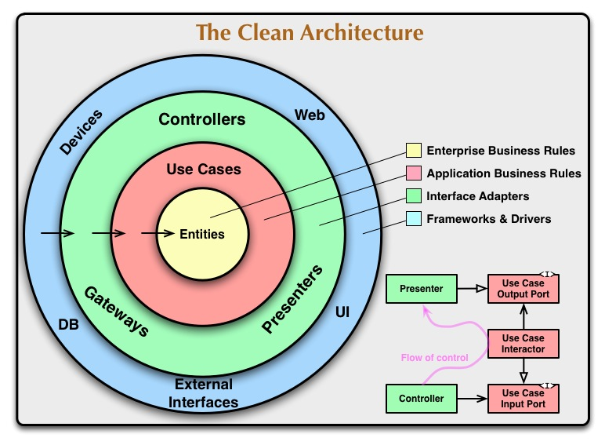
Part 4: Clean Architecture

Slide 17
Enterprise application layers
Controller (HTTP request processing)
Domain service (business logic)
Repository (database queries)
Additional layers:
Mappers
Validators
Helpers
API clients

Slide 18
Controller
Map request parameters to internal data structures;
Invoke domain services;
Map internal data structures to response schema.

Slide 19
Domain service
Perform operations that have real-world business equivalents;
Contains business rules, makes decisions based on the input;
Avoids using frameworks and making external calls directly;
Can rely on other domain service.

Slide 20
Repository
Perform a database operation;
Unopinionated, should have no knowledge about how system is going to work and what are the business requirements;
Should expose enough parameters for business service to cover all practical use cases.

Slide 21
Mapper
Convert data from one format to another;
Stateless, unopinionated, synchronous;
No external calls.

Slide 22
Validator
Encapsulates a set of rules defining how a valid instance of something has to look like;
Returns a list of errors; should not affect execution flow (e. g. throw an error);
Domain service or controller should make a decision with regards to how errors need to be handled.

Slide 23
Helper
Encapsulates reusable logic;
Avoid making overly broad helpers: “dateUtils” is fine, “utils” is not;

Slide 24
API client
Unopinionated wrapper over an external API;
Mirrors schema of an external API, makes no assumptions over how it should be used;
All decisions with regards to how API needs to be used should reside within a domain service.

Slide 25
Recommended reading
“A Philosophy of Software Design”, John Ousterhout;
“Fundamentals of Software Architecture”, Mark Richards, Neal Ford;
“Refactoring: Improving the Design of Existing Code (2nd Edition)”, Martin Fowler;
“Implementation Patterns”, Kent Beck.

Slide 26

Thank you!
If you have questions or complaints,
now is the time!

